Slide 1

HRR Genes Databases

Slide 2

Project Background
HRR process (homologus recombinational repair) is a major DNA repair pathway that provides a mechanism for the error-free removal of damage present in DNA.
The impairment of HRR process is called homlogous recombinaion repair deficiency (HRD) and genes involved in this pathway. such as BRCA1/2 or PALB2 needed for repair can be either mutated within the tumor or germline.
PARP inhibitors have shown great promise in BRCA deficent cells in clinical studies, and several have been approved for treatment of ovarian, breast, prostate and pancreatic cancers in different clinical settings. This has led to HRD positivist as a new biomarker for patient stratification.

Slide 3
Project Objectives
To make a database of HRR genes associated details observed from under-represented Indian Cancer Cohort.
To make exploration of HRR genes easier

Slide 4
Project’s Cohort
Parameter | Count
Total Number of Samples | 1434
Total Number of Annotated Samples | 607
Total Number of Samples with VCF | 457
Total Number of Samples with NO VCF | 370

Slide 5
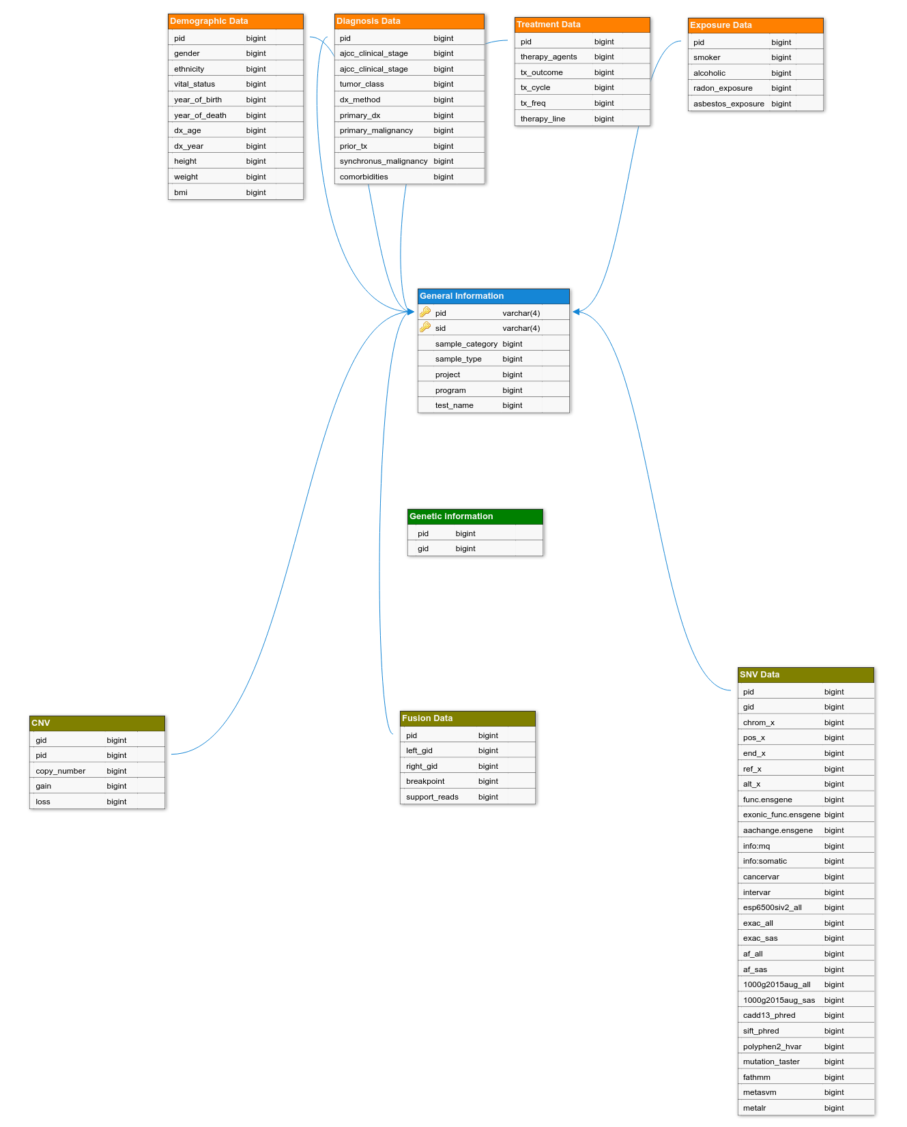
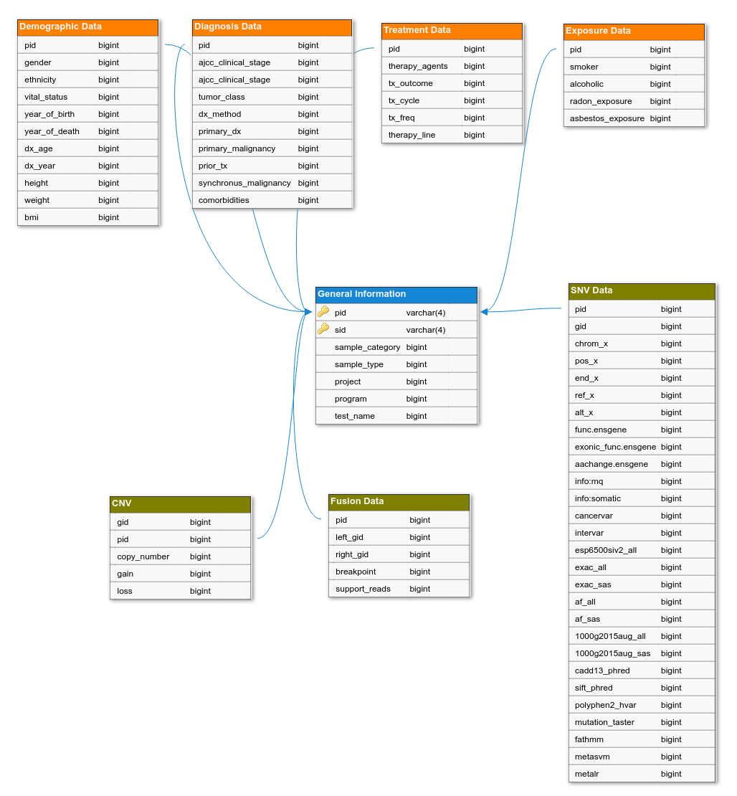
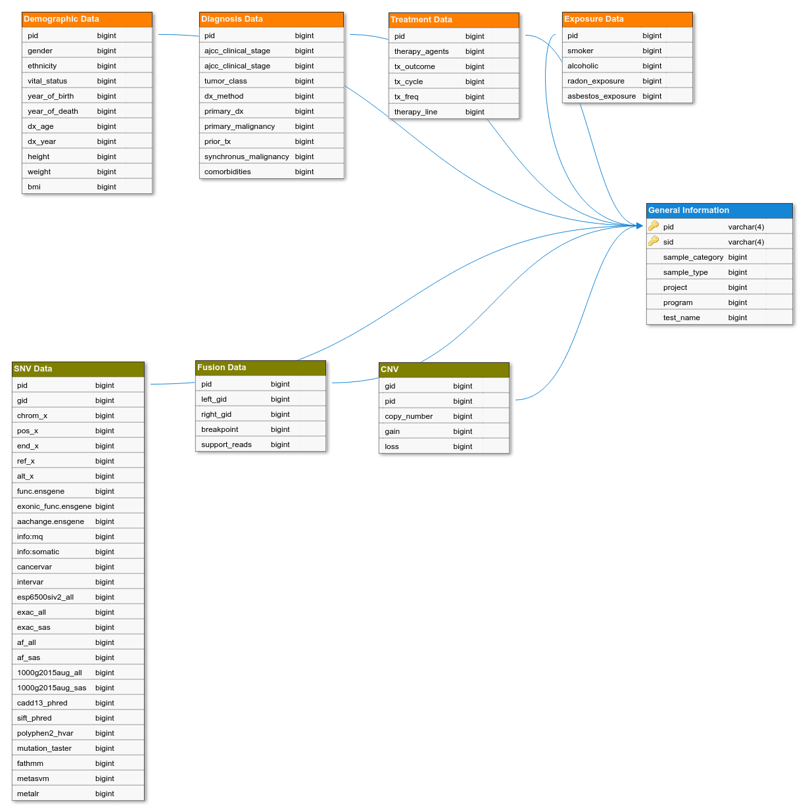
Work Done So Far

Slide 6
Support Needed

